Slide 1
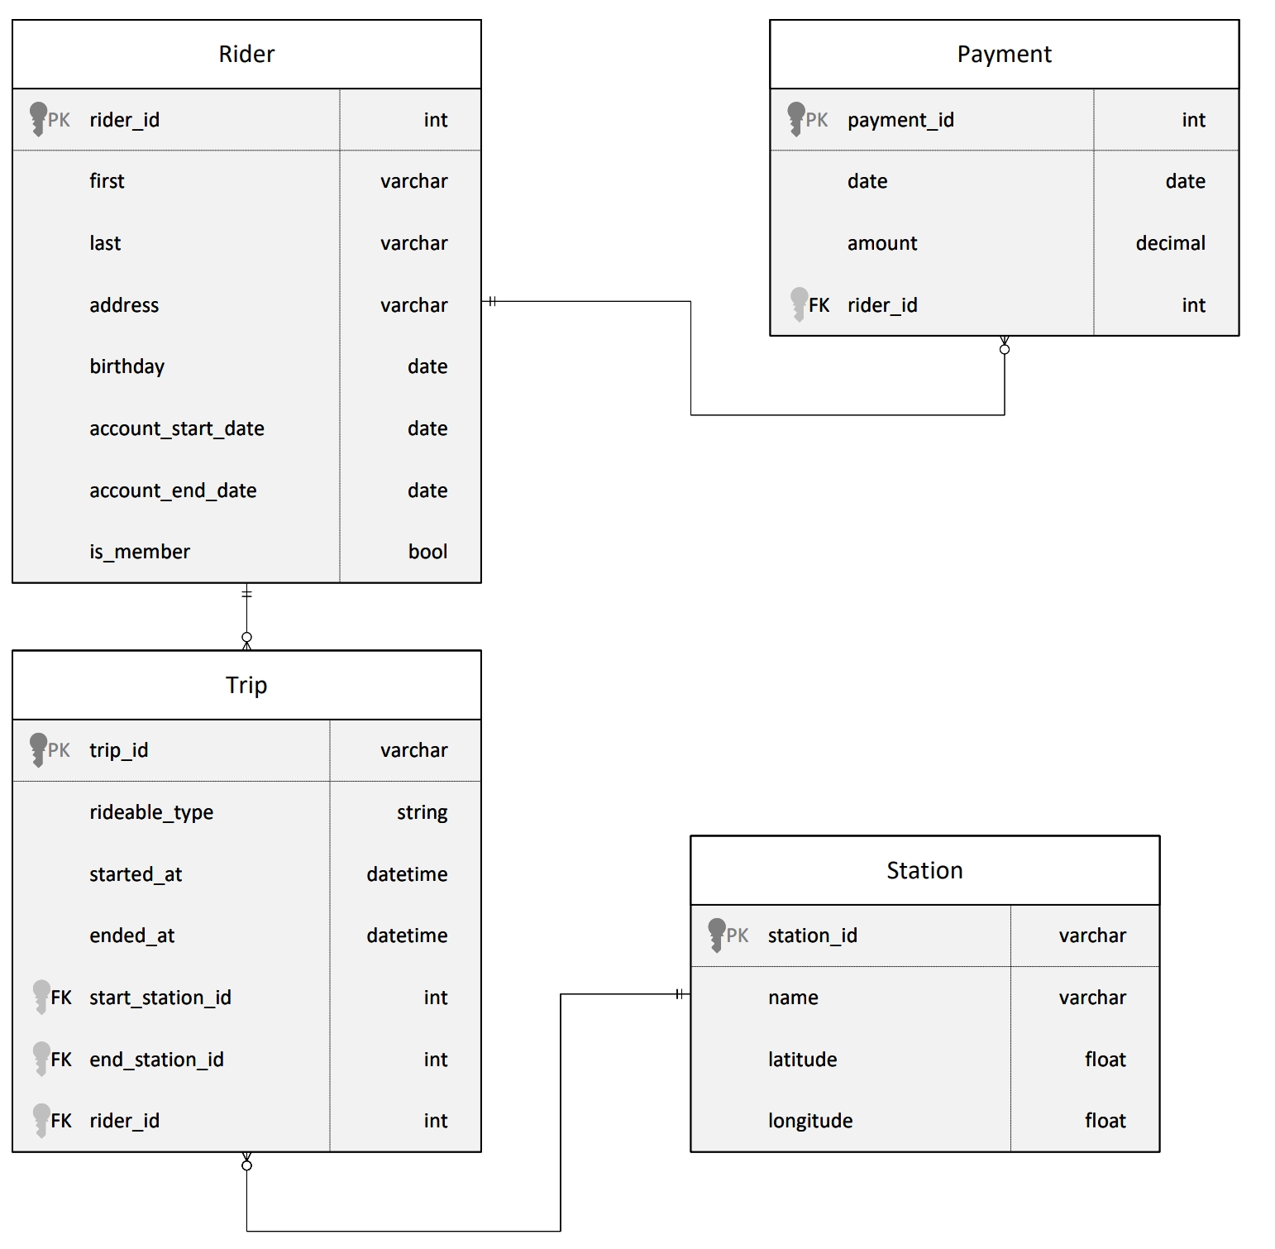

Project: Building an Azure Data Lake for Bike Share Data Analytics
Project Overview
In this project, you'll build a data lake solution for Divvy bikeshare.
Divvy is a bike sharing program in Chicago, Illinois USA that allows riders to purchase a pass at a kiosk or use a mobile application to unlock a bike at stations around the city and use the bike for a specified amount of time. The bikes can be returned to the same station or to another station. The City of Chicago makes the anonymized bike trip data publicly available for projects like this where we can analyze the data.
Since the data from Divvy are anonymous, we have generated fake rider and account profiles along with fake payment data to go along with the data from Divvy.
The dataset looks like this:
The goal of this project is to develop a data lake solution using Azure Databricks using a lake house architecture. You will:
Design a star schema based on the business outcomes listed below;
Import the data into Azure Databricks using Delta Lake to create a Bronze data store;
Create a gold data store in Delta Lake tables;
Transform the data into the star schema for a Gold data store;

Slide 2
Project: Building an Azure Data Lake for Bike Share Data Analytics
The business outcomes you are designing for are as follows:
Analyze how much time is spent per ride
Based on date and time factors such as day of week and time of day
Based on which station is the starting and / or ending station
Based on age of the rider at time of the ride
Based on whether the rider is a member or a casual rider
Analyze how much money is spent
Per month, quarter, year
Per member, based on the age of the rider at account start
EXTRA CREDIT - Analyze how much money is spent per member
Based on how many rides the rider averages per month
Based on how many minutes the rider spends on a bike per month

Slide 3
Project: Building an Azure Data Lake for Bike Share Data Analytics
Project Environment
In order to complete this project, you'll need to use these tools:
Access to Microsoft Azure. Instructions for accessing an Azure account where you can create the resources necessary for the project are on the previous page.
Hint: To view your DBFS files, enable the DBFS file browser in Databricks by going to Admin Console -> Workspace Settings -> Advanced
Hint: If you are going to use PySpark Pandas, make sure you create your Spark Cluster using a Databricks runtime >= 10.0
Starter Code and Data
You'll need the dataset from the course resources menu in the left navigation bar. Instructions for how to use the data in your project are on the next page in the project instructions
Workspace Instructions
Coming Soon!

Slide 4
Project: Building an Azure Data Lake for Bike Share Data Analytics
Project Instructions
The goal of this project is to develop a data lake solution using Azure Databricks using a lake house architecture. You will:
Design a star schema based on the business outcomes below;
Import the data into Azure Databricks using Delta Lake to create a Bronze data store;
Create a gold data store in Delta Lake tables;
Transform the data into the star schema for a Gold data store;
You'll implement these requirements by creating a Python notebook, or notebooks in the Azure Databricks workspace. Detailed requirements for what should be in the notebook can be found in the project rubric. You'll submit your notebook(s) and they'll be assessed against this rubric when you submit your project.

Slide 5
Project: Building an Azure Data Lake for Bike Share Data Analytics
The business outcomes you are designing for:
Analyze how much time is spent per ride
Based on date and time factors such as day of week and time of day
Based on which station is the starting and / or ending station
Based on age of the rider at time of the ride
Based on whether the rider is a member or a casual rider
Analyze how much money is spent
Per month, quarter, year
Per member, based on the age of the rider at account start
EXTRA CREDIT - Analyze how much money is spent per member
Based on how many rides the rider averages per month
Based on how many minutes the rider spends on a bike per month
Design a star schema for these business outcomes. Create a PDF of the schema you'll submit along with your Azure Databricks notebook file(s).

Slide 6
Project: Building an Azure Data Lake for Bike Share Data Analytics
Submission Instructions
Here is a list of things to submit for this project. Create a zip file containing:
PDF of the star schema you designed based on the relational diagram and the business problems outlined
Your Azure Databricks notebook(s)
Your submission will be assessed against this rubric
Take a moment and make sure your project is complete before submitting it.

